Slide 1

fellow research from a fellow fellow
*disclaimer: what follows are my views and not the views of…
Brian Locke
Notes:
Thoughts… make this a little less aimed toward; do what you want?

Slide 2
Consider each before proceeding…
3 Components of a Project:
Research Question ***Data*** Methods

Slide 3

Research Question
Traditional Paradigm | ”Free Range” Approach
Find a mentor who is investigating what you are interested in. Learn how to do what they are doing Ultimately branch out later in your career | Formulate a question that interests you Determine what data you can use to answer it Find a group of collaborators
The only thing that works for
You’re limited to what people are doing | Might flop; big time investment
Significance
Contingency
x
Tractability
Neglected-ness
Leverage
Notes:
Sometimes comes with choosing a mentor
Or, you can choose a question yourself
Risk-reward

Slide 4

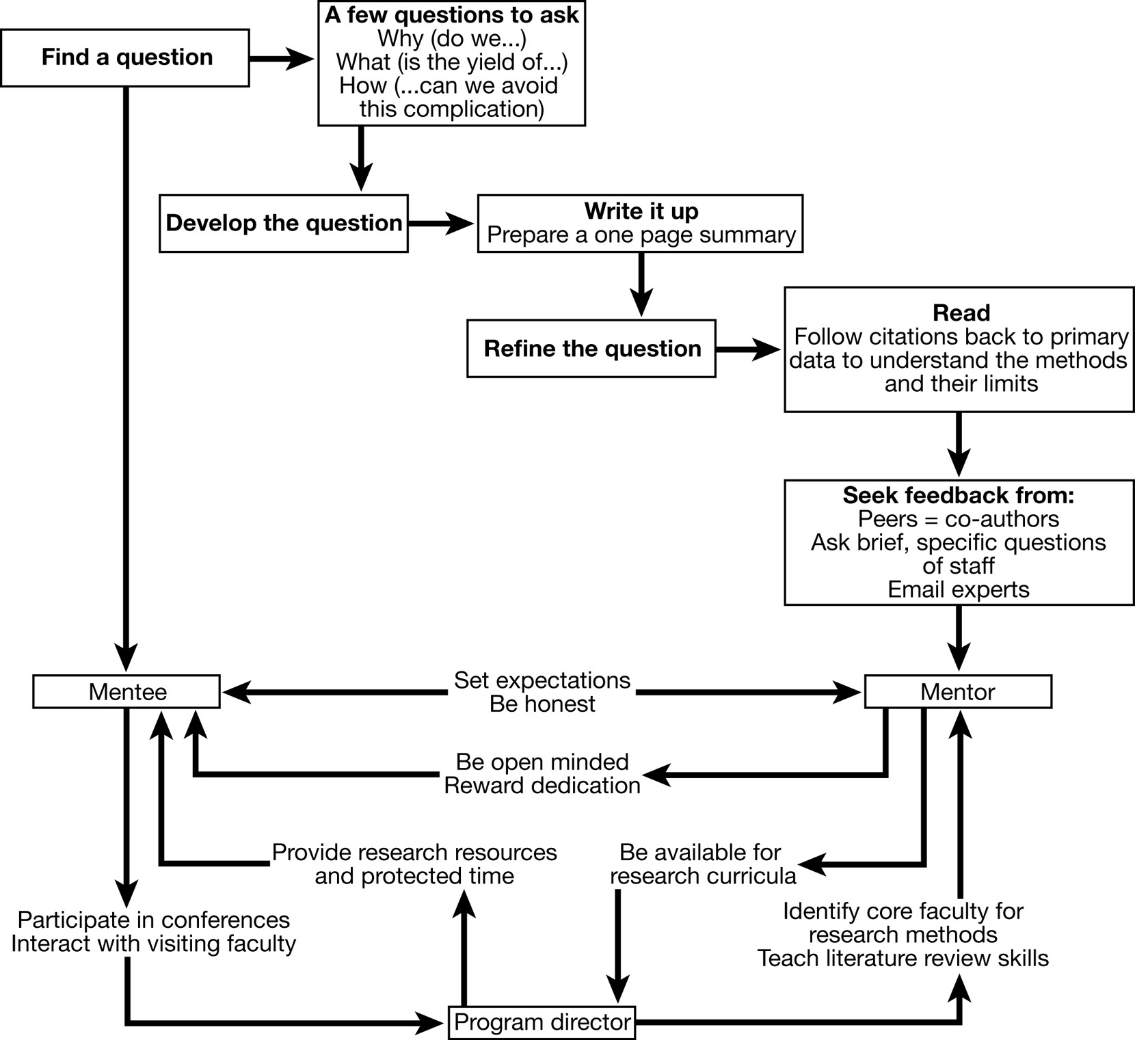
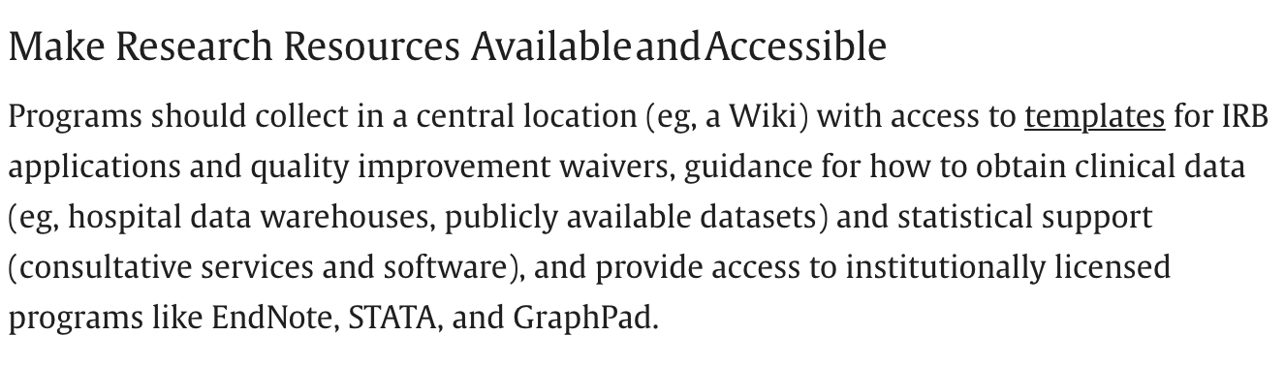
Notes:
Emphasize that you need METHODS mentors (or experts), not SUBJECT mentors.

Slide 5

Why do mentors mentor?
Intrinsic:
Training the Next Generation; Improve Medicine; Fun
Incentives:
Clinical Track (majority) – need impact outside of the institution (“excellence”) in 2 of: Clinical Care, Education, Administration, and Research
Tenure Track or similar (minority) – hired (and promoted) to get extra-mural grants: you are helpful to the extent you facility this (publications, preliminary work).
Favors executing previously-conceived projects; has ability/skill
Notes:
What do you want to get from this? (Everyone wants to graduate)
See if you can make academic research work?
See if you like doing research?
Gain quantitative skills? Writing skills? Reasoning Skills?
[ ] Emphasize differences in TIME to devote to research here

Slide 6
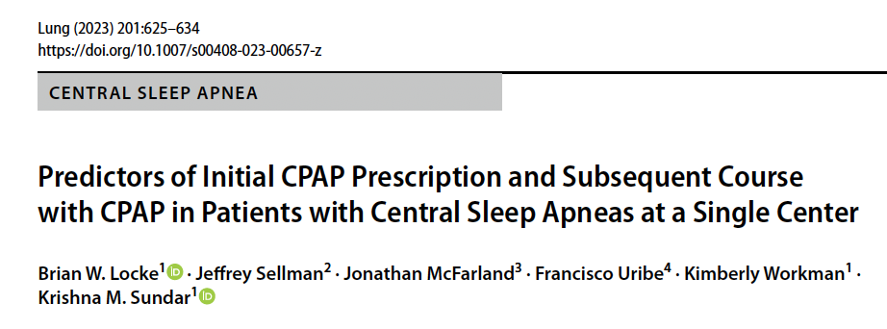
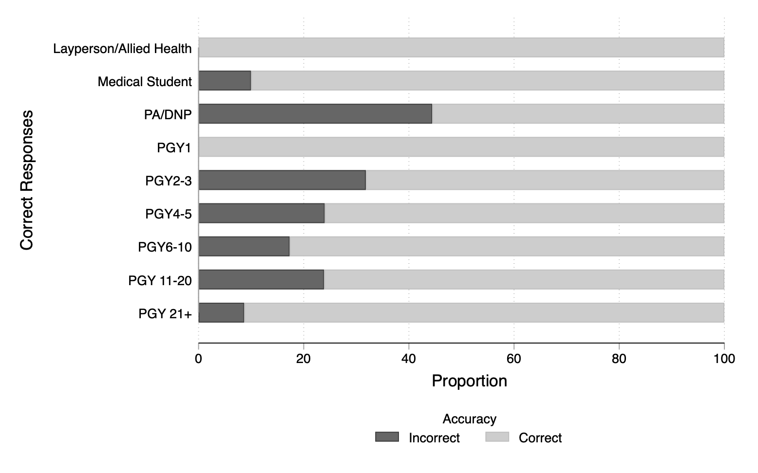
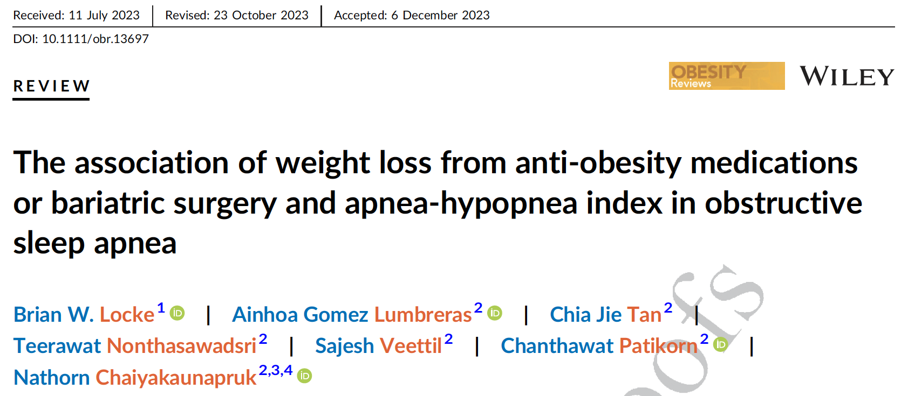
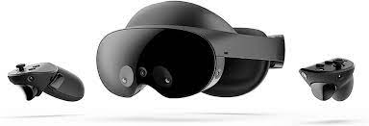
***What Data Are You Going To Use***
Database work | Chart Review | Meta-research | Survey | Prospective | Basic Science
Do we have access to it now? How much data-cleaning is needed? Can it answer the question? | How big? How long will it take? Can it be used for multiple things? | Systematic Reviews with or without meta-analysis | Who will be surveyed and how will it be done? | Do a feasibility study at most. | ???

Slide 7
***What Data Are You Going To Use***
Database work | Chart Review | Meta-research | Survey | Prospective | Basic Science
Do we have access to it now? How much data-cleaning is needed? Can it answer the question? | How big? How long will it take? Can it be used for multiple things? | Systematic Reviews with or without meta-analysis | Who will be surveyed and how will it be done? | Do a feasibility study at most. | ???
Data cleaning is time/expertise intensive | Chart Review is low yield | Time (and team) intensive | Unique methods expertise; limited impact | Inflexible time commitment, mentor dependent
Notes:
CTSI srma core, meta-analysis course,

Slide 8
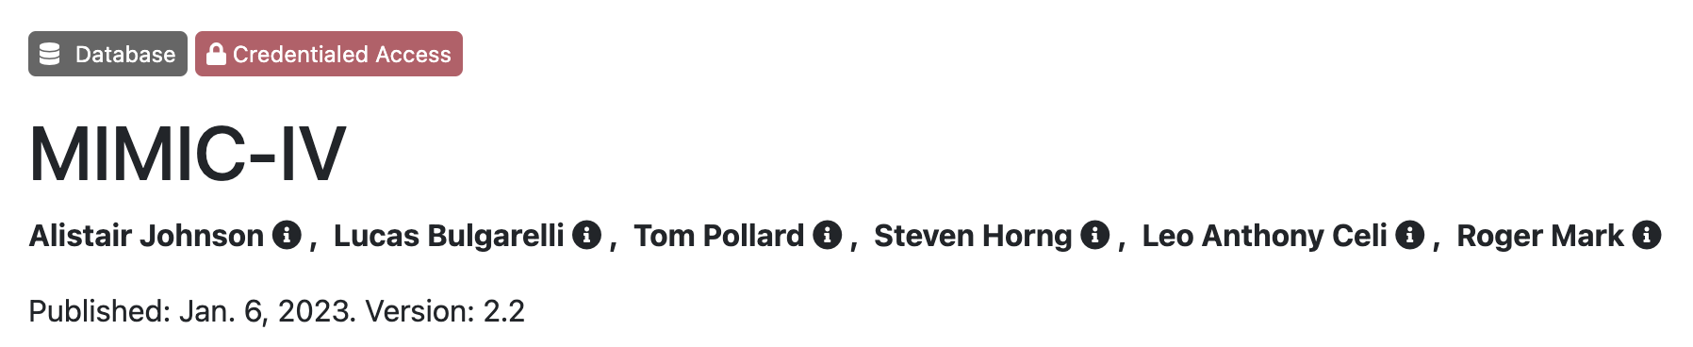
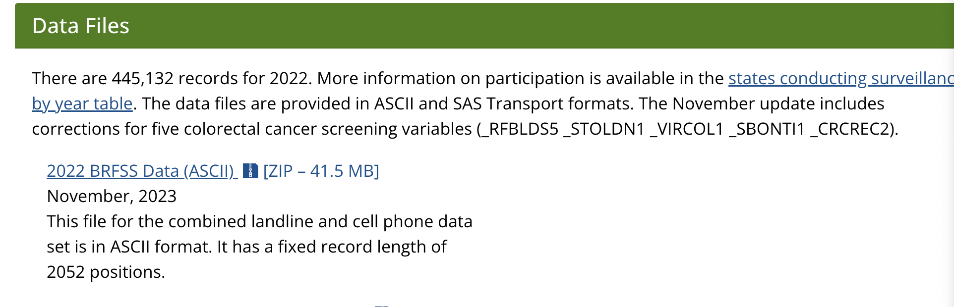

Databases
Health-Record Data
TriNetX -> Ram Gouripeddi
Epic Cosmos -> Vik Deshmukh (IM pays for expedited data requests)
ICU Databases:
Community Cohorts:
Trial Data:

Slide 9

Methods:
Who is going to do the statistics?**
Who will help you design the study?
“Traditional Mentorship Structure”: they provide
Otherwise… resources:
CTSI
MSCI

Slide 10
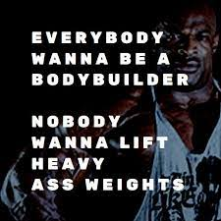
How can I help?
What Can I Offer? | What I Can’t Offer
I have some ideas I can do (and teach) the needed study design, epi/statistics, and database skills I want (and am incentivized) to collaborate or advise on other projects I think it is very helpful to have external advisors I’ve (big) helped with Brittany and Jeff’s projects and (little) helped with Ryan, Jared, and Darren’s | I cannot provide resources (statisticians, study coordinators, grad students) I cannot offer advocacy that carries weight I would not be a wise primary-mentor for someone who wants a primary research career But, I can help
Notes:
Computer Science BSc
CMR: EBM and Resident Research
AASM Young Investigators Research Forum
ATS ASPIRE Fellowship
U of U MSCI Program
→ NIH Career Development Application (K23)
1 in 3, 5-years, 75% Research Effort
AIM: Do research that most improves how we care for patients with severe cardiopulmonary disease:
Instrumental value to me:

Slide 11
Hypercapnic Respiratory Failure: Overall research premise
inflicts a high burden of disease (prevalence * morbidity)
is becoming a bigger problem (obesity, opiates, multimorbidity)
is (potentially) treatable with NIV, GLP-1Ra, etc.
but the current evidence base is inadequate
is comparatively neglected (biases against this type of patient)
Therefore, doing a better job recognizing hypercapnia will allow:
Better quantification (ie. research) about hypercapnia’s impacts
Better care for patients with known best management.

Slide 12
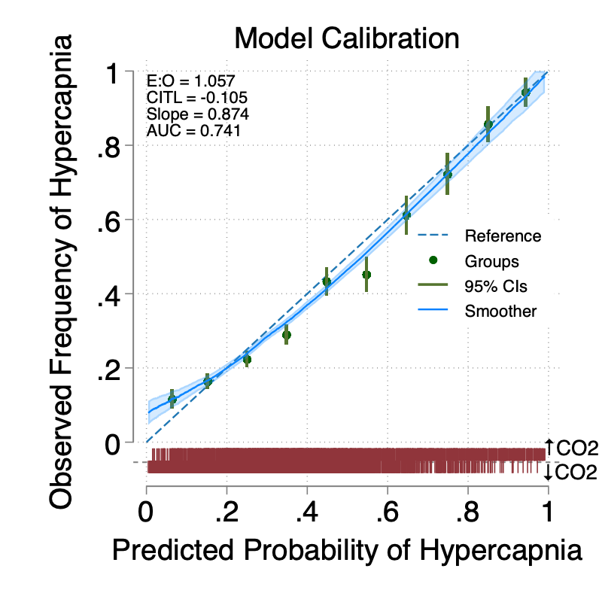
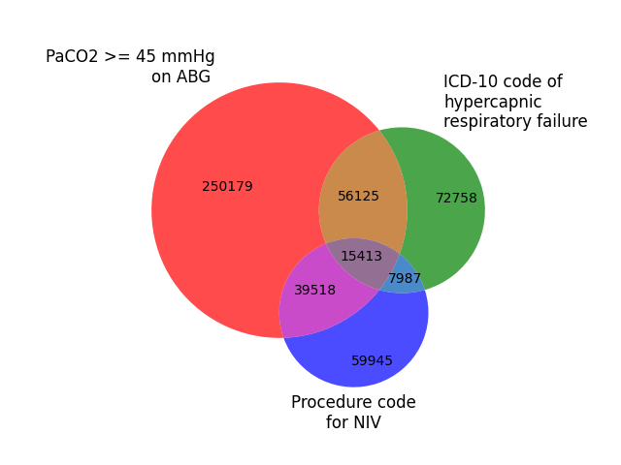
Completed Research

Slide 13
Proposed Research (at least 2025 – 2030):
OVERALL: Patients with Consequentially-Missed Hypercapnia can be Identified Using Health Record Elements | OVERALL: There is a significant burden of unrecognized hypercapnia among hospitalized patients. 3 aims
 | Aim 1: Use NLP / AI to incorporate unstructured data | Aim 2: Prospective Validation of Positive Predictive Value | Aim 3: Assess Potential Impact of Unrecognized Hypercapnia
Hypothesis | RN/ED Triage note symptoms simple NLP (CLAMP) vs Large-Language Models | ‘Risk’-modeling can identify inpatients missed by their teams | Patients predicted likely to have had unrecognized hypercapnia suffer adverse outcomes, like readmission.
Rationale | Signs/Symptoms improve accuracy e.g. STOP-BANG for OSA | Must be verified to identify unrecognized hypercapnia | Would expanded recognition lead to overdiagnosis?
Approach | Train & evaluate performance on retrospective, local health records | Prospectively apply TcCO2 to inpatients predicted likely to have hypercapnia – do they? | ↑readmission mortality In patients who likely had hypercapnia? # likely hypercapnia admissions prior to actual recognition?
Payoff: Allow hypercapnic respiratory failure -not dependent on clinician identification- as an exposure or outcome
Career Development: Skillset bridging bioinformatics and clinical investigation required to validate promising technology

Slide 14
In the interim, preliminary work needed…
strengthen the case to investigate hypercapnia
augment tools to study hypercapnia epi
Inpatient Hypercapnic Respiratory Failure
 | ABG CO2>45 vs VBG CO2>50 | Who gets steroids / antibiotics / diuretics | National Consequence of ↑ICD | Who is diagnosed / managed as OHS? | Dysutility of FP vs FN during hypercap workup
Hypothesis | Vent Support, Dx is equivalent | Most get kitchen sink | High Readmission Rates | Conditions that exclude OHS vary | FN currently underweighted
Data | TriNetX (cleaning done) | TriNetX (cleaning done) | National Inpatient Sample | Survey | Group Session Survey
Methods | Descriptive Stats, Regressions | Descriptive Stats, Regressions | Descriptive Stats, Regression | Randomized Vignette’s | Anchor-based
Team | Somya Mishra (Anesth/Sleep Fellow) |  | Chaiyakunapruk (Pharm/Econ)
Notes:
[ ] this has good info for FP/FN utility for risk modeling. https://bmcmedicine.biomedcentral.com/articles/10.1186/s12916-019-1425-3
And justification for it (wrt the modeling)
[ ] Limitation: we do not have the needed groundwork to assess clinical utility (e.g. by calculating the Net Benefit, but this is an area of needed future research
— We need the threshold probability where the expected benefit of ordering an ABG is equivalent to the expected benefit of not ordering an ABG. [ ] note: this is the
—The threshold (𝑝threshold) for calculating net benefit should be chosen before analysis, based on discussion with clinical experts and patient focus groups, and indeed there may rather be a range of thresholds of interest, as a single threshold is unlikely to be acceptable in all clinical settings and individuals. http://dx.doi.org/10.1136/

Slide 15
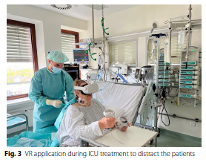
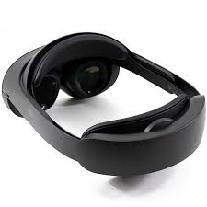
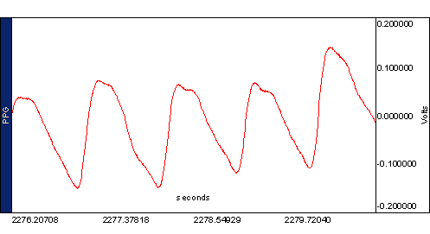

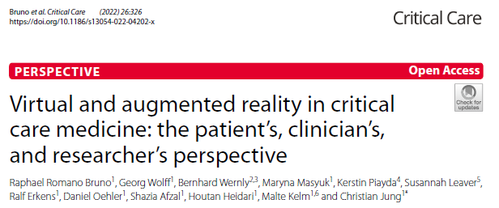
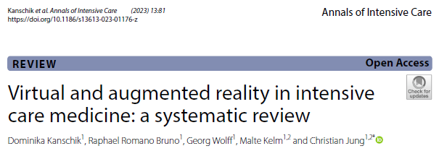
Immersive Virtual Reality – Joseph Finkelstein MD PhD MA, Dept Bioinformatics
VR: immersive (headset) vs non-immersive (computer game).
Immersion is the experience of being absorbed (termed, ‘presence’), forgetting their embodied presence and thus responding as if the environment is real.
ICU Use cases: Relaxation (several feasibility studies), Cognitive/physical mobilization (1 RCT), Distraction/pain control (1 RCT pre-op), Delirium*, Sleep (1 +RCT)
Feasibility Study (done) → Next Steps?

Slide 16
Hypercap. Diagnosis: ABG vs VBG
Problem: Emergency room providers often use VBGs to “diagnose” hypercapnia, but it’s unclear if they get managed like ABG-diagnosed
Study Question: Do patients admitted with VBGs suggestive of hypercapnia
Receive the same care (ie. ICD-codes of hypercapnic resp failure)
Have the same outcomes (ie. intubation rate, NIV use)
As those with ABGs confirming hypercapnia?
Data: Nationally aggregated EHR (TriNetX) of patients
Methods: Inverse Probability (of A/VBG)-Weighted Comparison
Notes:
What is the course of people who receives VBGs in the emergency department?
*** need data on where the lab was drawn... I think we actually have this.

Slide 17
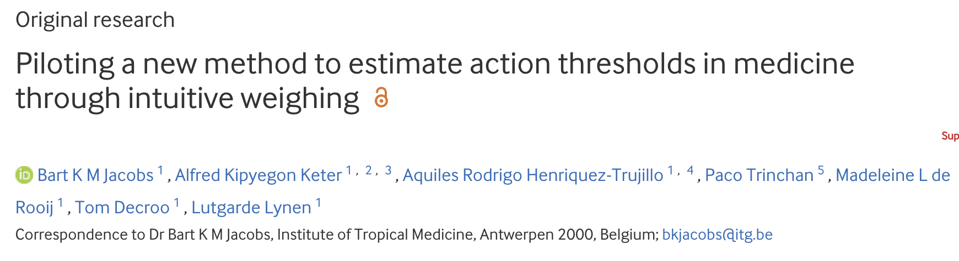
Hypercapnia Diagnostics: Harm of FP vs FN
Problem: Thresholds for any test [e.g. HCO3- level, Modeled Pr(Hypercap)] should be defined to minimize the dis-utility of incorrect results. No evidence exists for hypercapnia diagnosis.
Study Question: How bad is it to miss hypercapnia in comparison to overtesting/overdiagnosing it?
Data: Survey (initially, providers – via Hosp/PCCM/Sleep groups)
Methods: survey
Notes:
https://ebm.bmj.com/content/28/6/392

Slide 18
Diagnostic Criteria of OHS:
Problem
Study Question
Data
Methods

Slide 19
National Consequence of Hypercapnia Admissions
Problem
Study Question
Data
Methods

Slide 20
Jeanette Brown MD PhD
VR: immersive (headset) vs non-immersive (computer game).
Immersion is the experience of being absorbed (termed, ‘presence’), forgetting their embodied presence and thus responding as if the environment is real.
ICU Use cases: Relaxation (several feasibility studies), Cognitive/physical mobilization (1 RCT), Distraction/pain control (1 RCT pre-op), Delirium*, Sleep (1 +RCT)
Feasibility Study (done) → Next Steps?

